Slide 1



Microeconomics
Introduction

Slide 2
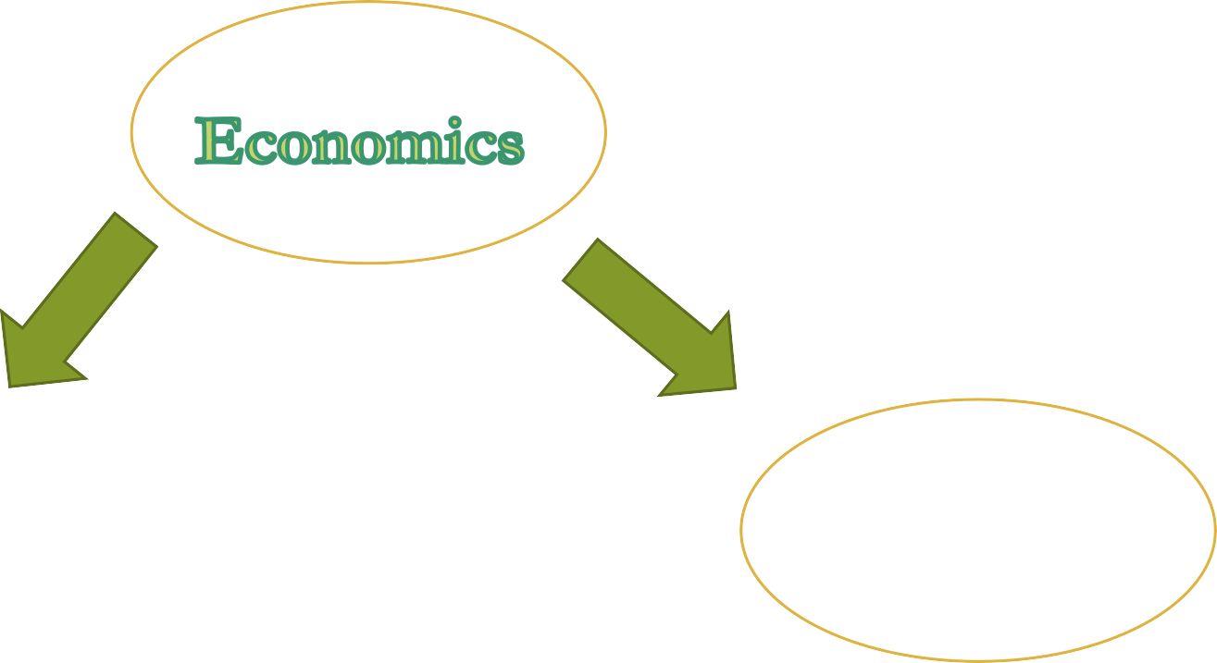
Microeconomics
Macroeconomics

Slide 3
Microeconomics can be defined as the study of decision-making behaviour of individuals, companies, and households with regards to the allocation of their resources.
Microeconomics strives to discover what factors contribute to peoples’ decisions, and what impact these choices have on the general market as far as price, demand, and supply of goods and services is concerned.

Slide 4
It’s a ‘bottom-up’ approach.
It aims to understand the pattern of wages, employment, and income, as well as consumer behaviour, spending trends, wage-price behaviour, corporate policies, and how regulations impact companies.
Microeconomics tries to determine decisions and resource allocation at an individual level, as well as explain what happens when certain conditions change.

Slide 5
MICROECONOMICS
Branch of economics that studies single, individual unit of an economy like individual, firm, household etc and their behaviour.
Thus it is the study which seeks to explain how a consumer uses his limited income in various goods and services to maximise his satisfaction and how a firm decides its course of production to attain maximum profit.

Slide 6
Factors of production
Land: any natural resource. Most common land.
Labour: Mental and physical capacity of workers to produce goods
Capital: Financial help to put up and run a production unit
Raw Materials: Materials to be transformed into finished goods
Entrepreneurs: Creative ability of individuals to seek profits by combining resources to produce innovative products

Slide 7
Importance of microeconomics
Micro economics studies behaviour of individual consumer or producer in a particular situation.
Micro economics decides prices of various goods and services on the basis of 'Demand-Supply Analysis'.

Slide 8
Microeconomics answers following questions:
How a firm determines the sale price of its products?
What amount of output will maximise its profit?
What is the ratio of individual income for consumption of particular good
or service?
What is the relation between individual income and individual consumption?
How individual factors of production are determined?

Slide 9
Limitations of Microeconomics
Unrealistic Assumptions: It assumes uniformity of taste, income, expectations etc which is not possible in real world
Inadequate Data: Micro economics is based on the information dealing with individual behaviour, individual customers which is difficult to determine accurately.

Slide 10
Parameters | Microeconomics | Macroeconomics
Production | Production of individual units E.g. How much steel is produced by a single firm | Production of whole economy (Gross Domestic Product/ Total industrial output)
Prices | Price of individual goods and services E.g. Food prices, house rents | Aggregate price Level E.g. Consumer price, Producer price
Income | Distribution of wealth: Wages in particular industry/firm | National income: Total wages and salaries
Employment | Jobs in particular industry | Employment and unemployment issues in an economy

Slide 11


THEORY OF CONSUMER BEHAVIOUR

Slide 12
Introduction to Consumer Behaviour
In economics the study of consumer behaviour occupies an important place
The problem of a consumer consists of three things: (a) the object, (b) the constraints, and (c) the decision variable
Object – To maximize total utility (Satisfaction)
Constraint – Limited Resources (Income)
Decision Variable – the quantity purchased using limited resources

Slide 13
CHOICE AND UTILITY THEORY
In explaining consumer behaviour, economics relies on the fundamental premise that people choose those goods and services they value most highly.
WHAT DO YOU MEAN BY UTILITY
Utility denotes satisfaction.
It refers to how consumers rank different goods and services
Utility is a scientific construct that economists use to understand how rational consumers divide their limited resources among the commodities that provide them with satisfaction.

Slide 14
Marginal utility and the law of diminishing marginal utility

Slide 15
How does utility apply to the theory of demand?
Example of consuming an ice-cream.
When you eat an additional unit of an ice-cream, you will get some additional satisfaction or utility. The increment to your utility is called marginal utility.
Marginal means extra or additional

Slide 16
Law of diminishing marginal utility
This law states that the amount of extra or marginal utility declines as a person consumes more and more of a good.
What is the reason for this law?
Utility tends to increase as you consume more of a good. However, according to the law of diminishing marginal utility, as you consume more and more, your total utility will grow at a slower and slower rate.

Slide 17
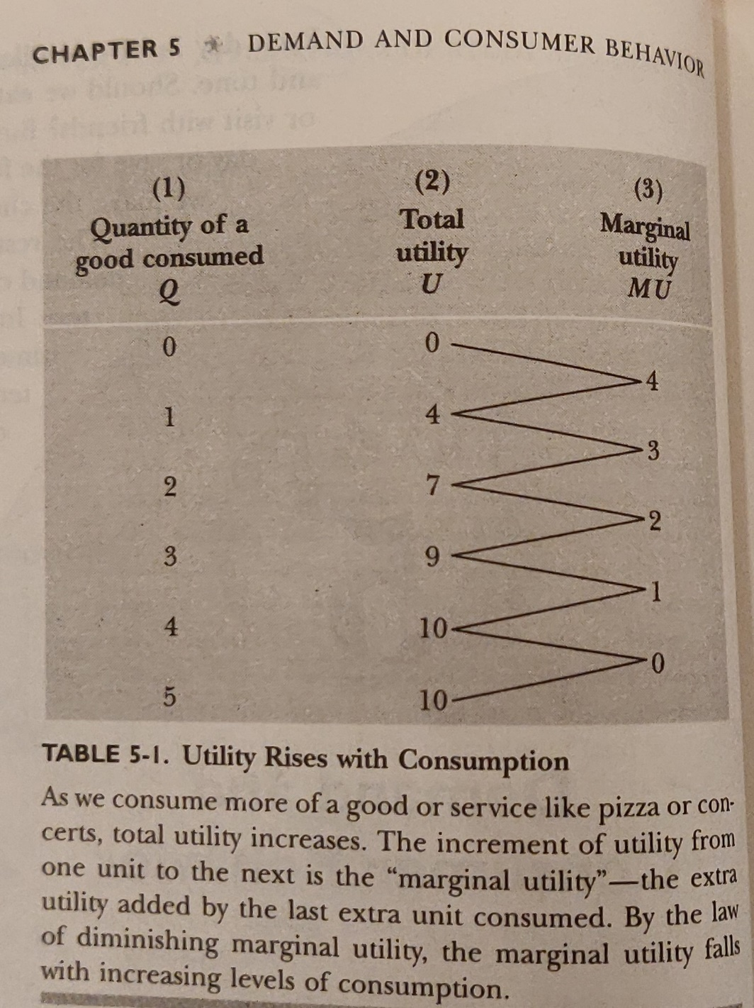
EXample

Slide 18
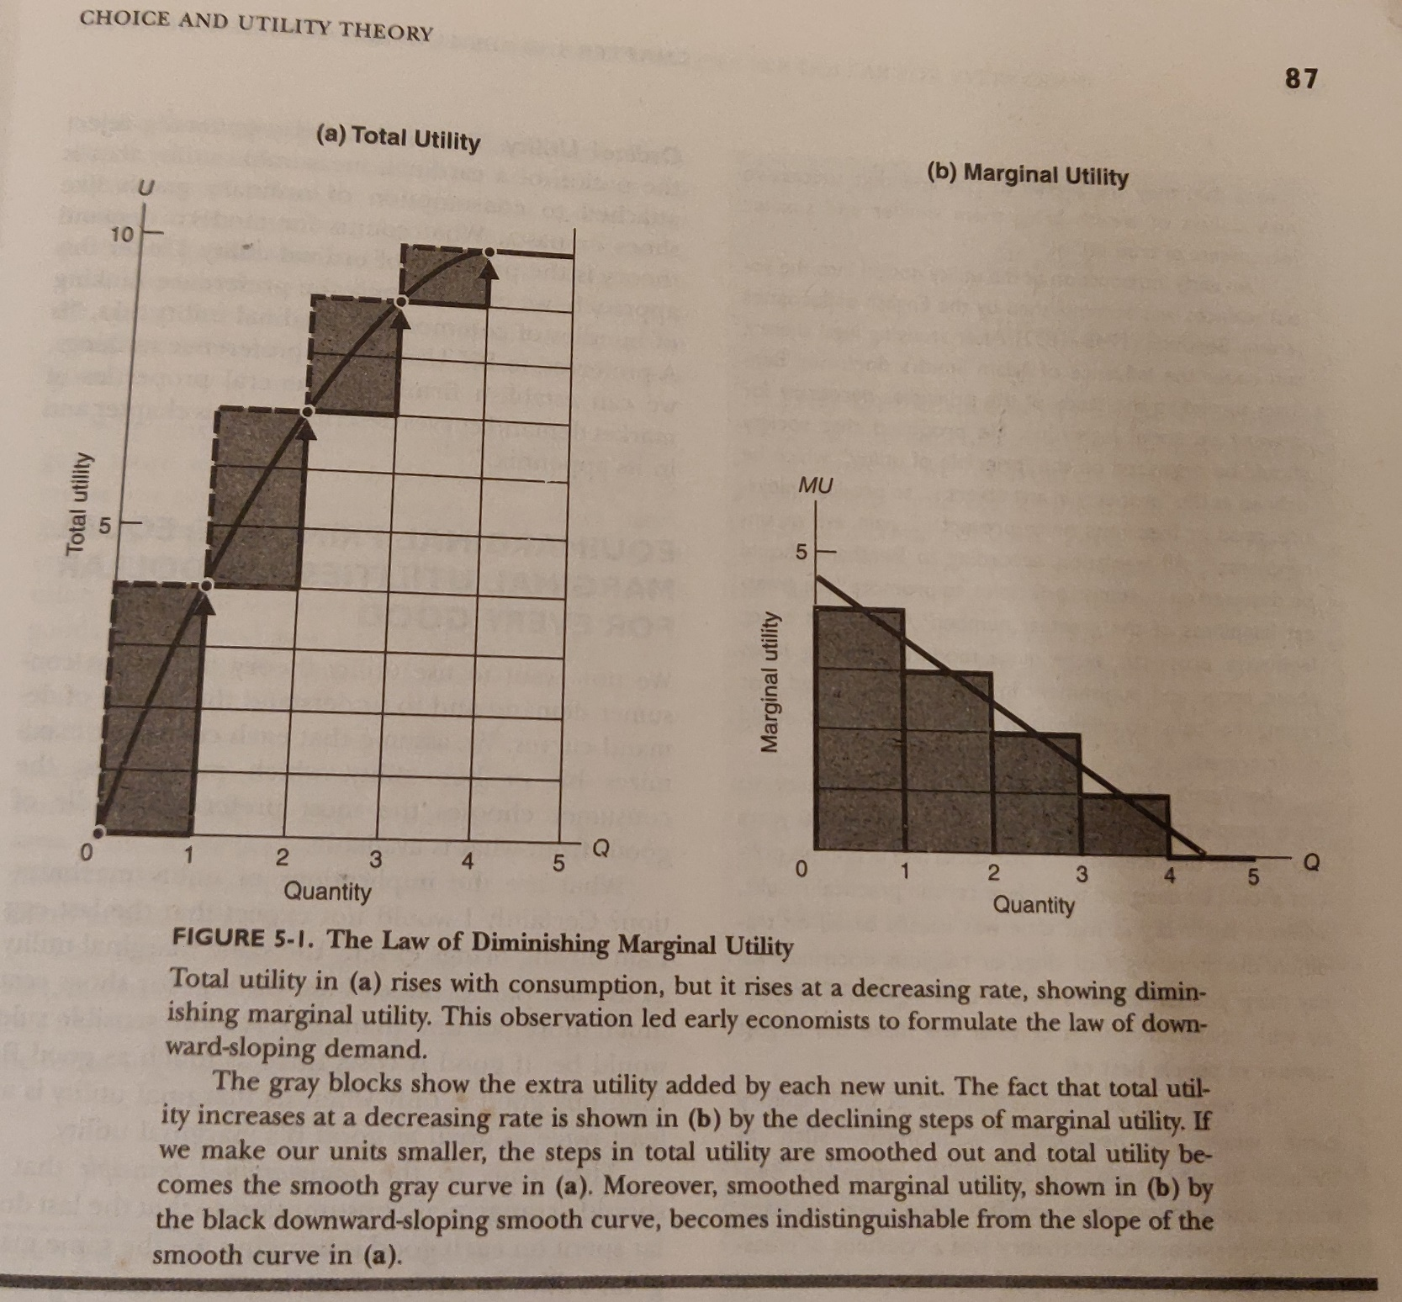

Slide 19
Law of DMU…Assumptions
The tastes and preferences of the consumer are given and unchanged.
The units of the commodity are homogeneous – in size, quality etc.
There is no time-lag between the consumption of the two units of a commodity.

Slide 20
PRODUCTION AND BUSINESS ORGANISATION

Slide 21
Theory of Production and Marginal Products
BASIC CONCEPT :
1. The Production Function The Production Function specifies the maximum output that can be produced with a given quantity of inputs. It is defined for a given state of engineering and technical knowledge.
2. Total, Average, and Marginal Product The marginal product of an input is the extra output produced by 1 additional unit of that input while other inputs are held constant.

Slide 22
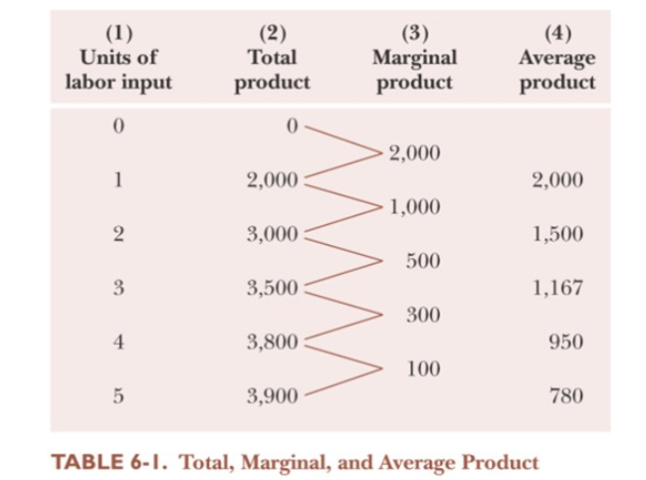

Slide 23
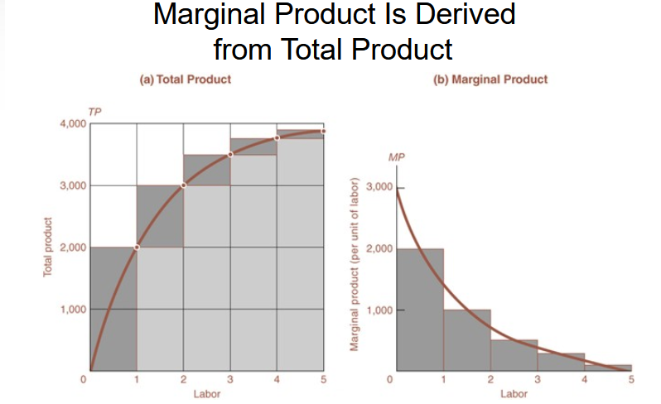

Slide 24
The Law of Diminishing Returns The law of diminishing returns holds that we will get less and less extra output when we add additional doses of an input while holding other inputs fixed. In other words, the marginal product of each unit of input will decline as the amount of that input increases, holding all other inputs constant.

Slide 25
BUSINESS ORGANIZATIONS
1.The Nature of The Firm
Business firms are specialized organizations devoted to managing the process of production. Production is organized in firms because efficiency generally requires large-scale production the raising of significant financial resources and careful management and monitoring of ongoing activities.
2.Big, Small and Infinitesimal Business
- The Individual Proprietorship
- The Partnership
- The Corporation

Slide 26
Sole Proprietorships
A sole proprietorship , also known as a sole tradership, individual entrepreneurship or proprietorship, is a type of enterprise owned and run by one person and in which there is no legal distinction between the owner and the business entity.
A sole trader does not necessarily work "alone"—it is possible for the sole trader to employ other people
Sole proprietorships are the most common form of business organization. Most sole proprietorships are small. A sole proprietorship is a business owned and managed by a single individual.

Slide 27
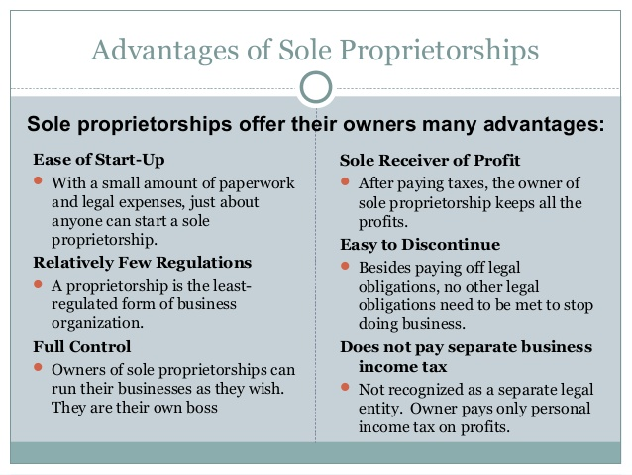

Slide 28
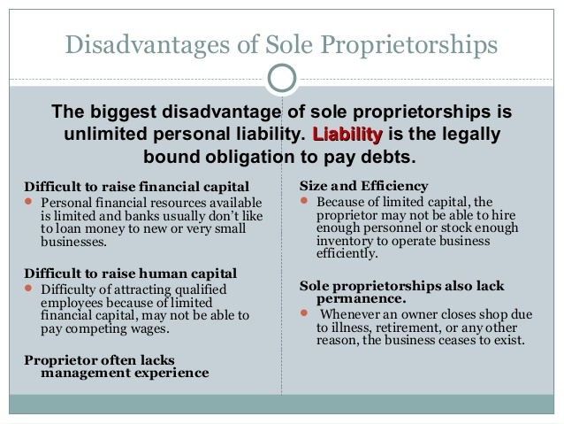

Slide 29
Partnerships
A partnership is a business jointly owned by two or more people
Types of Partnerships
Partnerships fall into three categories:
General Partnership - Partners share equally in both responsibility and liability.
Limited Partnership - Only one partner is required to be a general partner, or to have unlimited personal liability for the firm.
Limited Liability Partnership - All partners are limited partners.
Notes:
https://trak.in/business/what-is-limited-liability-partnership-llp-who-should-use-0811/
https://www.investopedia.com/terms/l/limitedpartnership.asp
Limited partnership are usually found in time-restricted projects, like filmmaking and real estate businesses. Director, writer, and editor of a movie serve as the general partners. ... Medical partnerships, law firms, and accounting firms are common examples of Limited Liability Partnership.

Slide 30
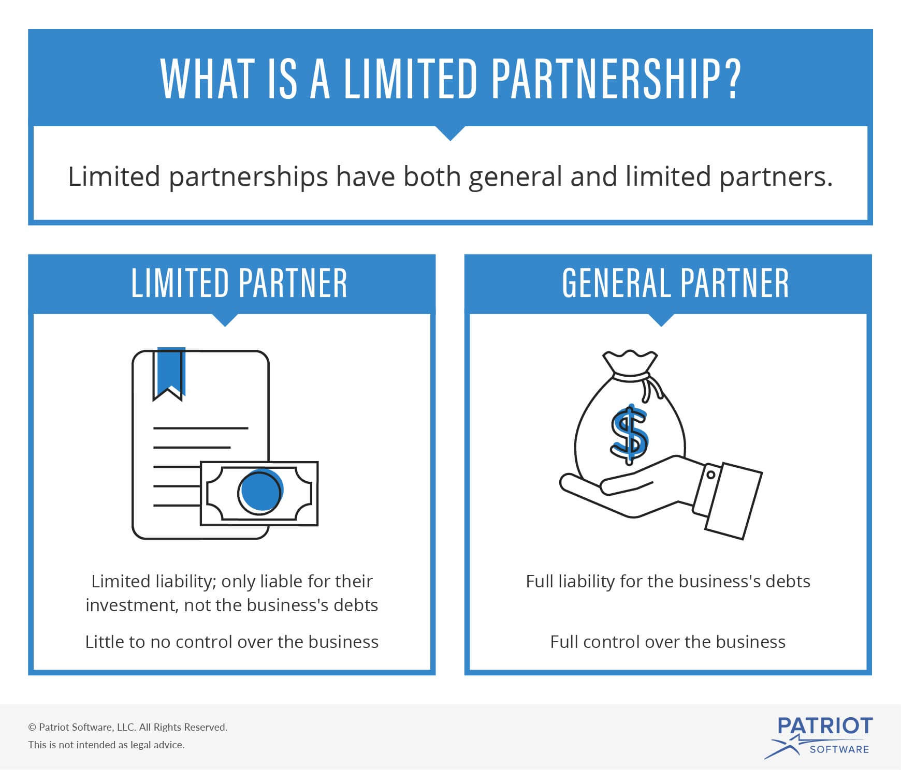

Slide 31
Advantages of Partnerships
Ease of Start-Up - Partnerships are easy to establish. There is no required partnership agreement, but it is recommended that partners develop articles of partnership.
Shared Decision Making and Specialization - In a successful partnership, each partner brings different strengths and skills to the business.
Larger Pool of Capital = Human Capital - Each partners assets, or money and other valuables, improve the firms ability to borrow funds for operations or expansion and attract top talent.
Taxation - Individual partners are subject to taxes, but the business itself does not have to pay taxes.

Slide 32
Disadvantages of Partnerships
Unless the partnership is a limited liability partnership, at least one partner has unlimited liability.
Partnerships also have the potential for conflict. Partners need to ensure that they agree about work habits, goals, management styles, ethics, and general business philosophies.

Slide 33
Corporations
Corporations are owned by individual stockholders.
Stocks, or shares, represent a stockholder’s portion of ownership of a corporation.
A corporation which issues stock to a limited a number of people is known as a closely held corporation.
A publicly held corporation buys and sells its stock on the open market. A corporation is a form of business organization recognized by law as a separate legal entity having all the rights of an individual.

Slide 34
Characteristics of Corporations
Must file a charter – a government document that gives permission to create a corporation.
States the name of the corporation, address ,purpose of the business, and other features of the business.
Charter also specifies the number of shares of stock, or ownership certificates in the firm.
Stocks are sold to investors, called stockholders.
The money is used to set up the corporation. If the corporation is profitable, it may eventually pay dividends.
Dividends – a check representing a portion of profits.

Slide 35
Common Stock
Represents basic ownership of a corporation
The value of one share of stock is determined by many factors pertaining to the company’s overall financial health and future production possibilities
1 share = 1 vote for each share of stock to elect board of directors
Board members direct the corporation’s business by setting broad policies and goals.

Slide 36
Preferred Stock
Represents non-voting ownership shares of the corporation.
These stockholders receive their dividends before common stockholders.
If corporation goes out of business and if some property and funds remain after all debts are settled, preferred stockholders get their investment back before common stockholders.

Slide 37
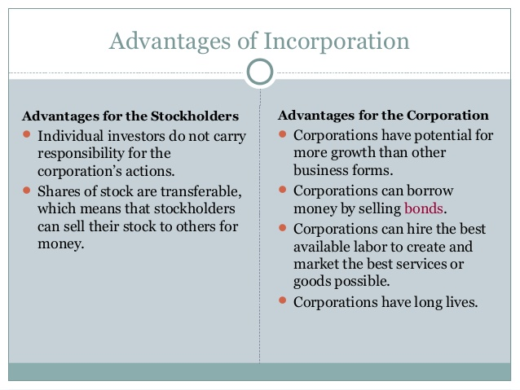

Slide 38
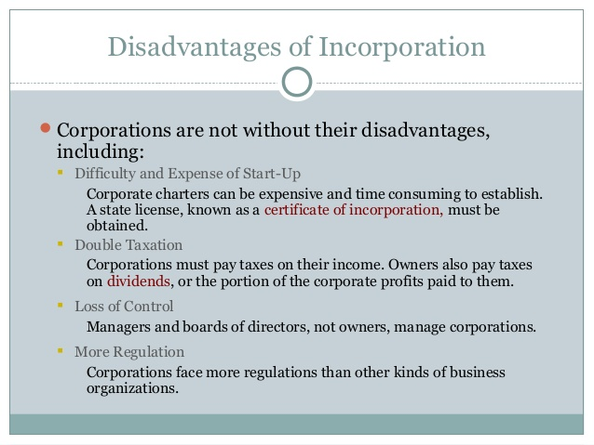

Slide 39
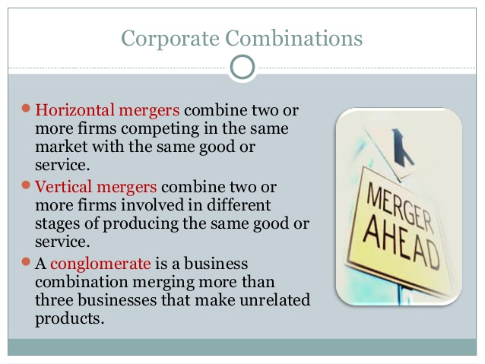

Slide 40
Analysis of cost

Slide 41
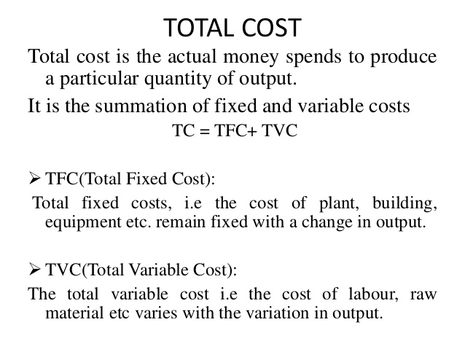

Slide 42
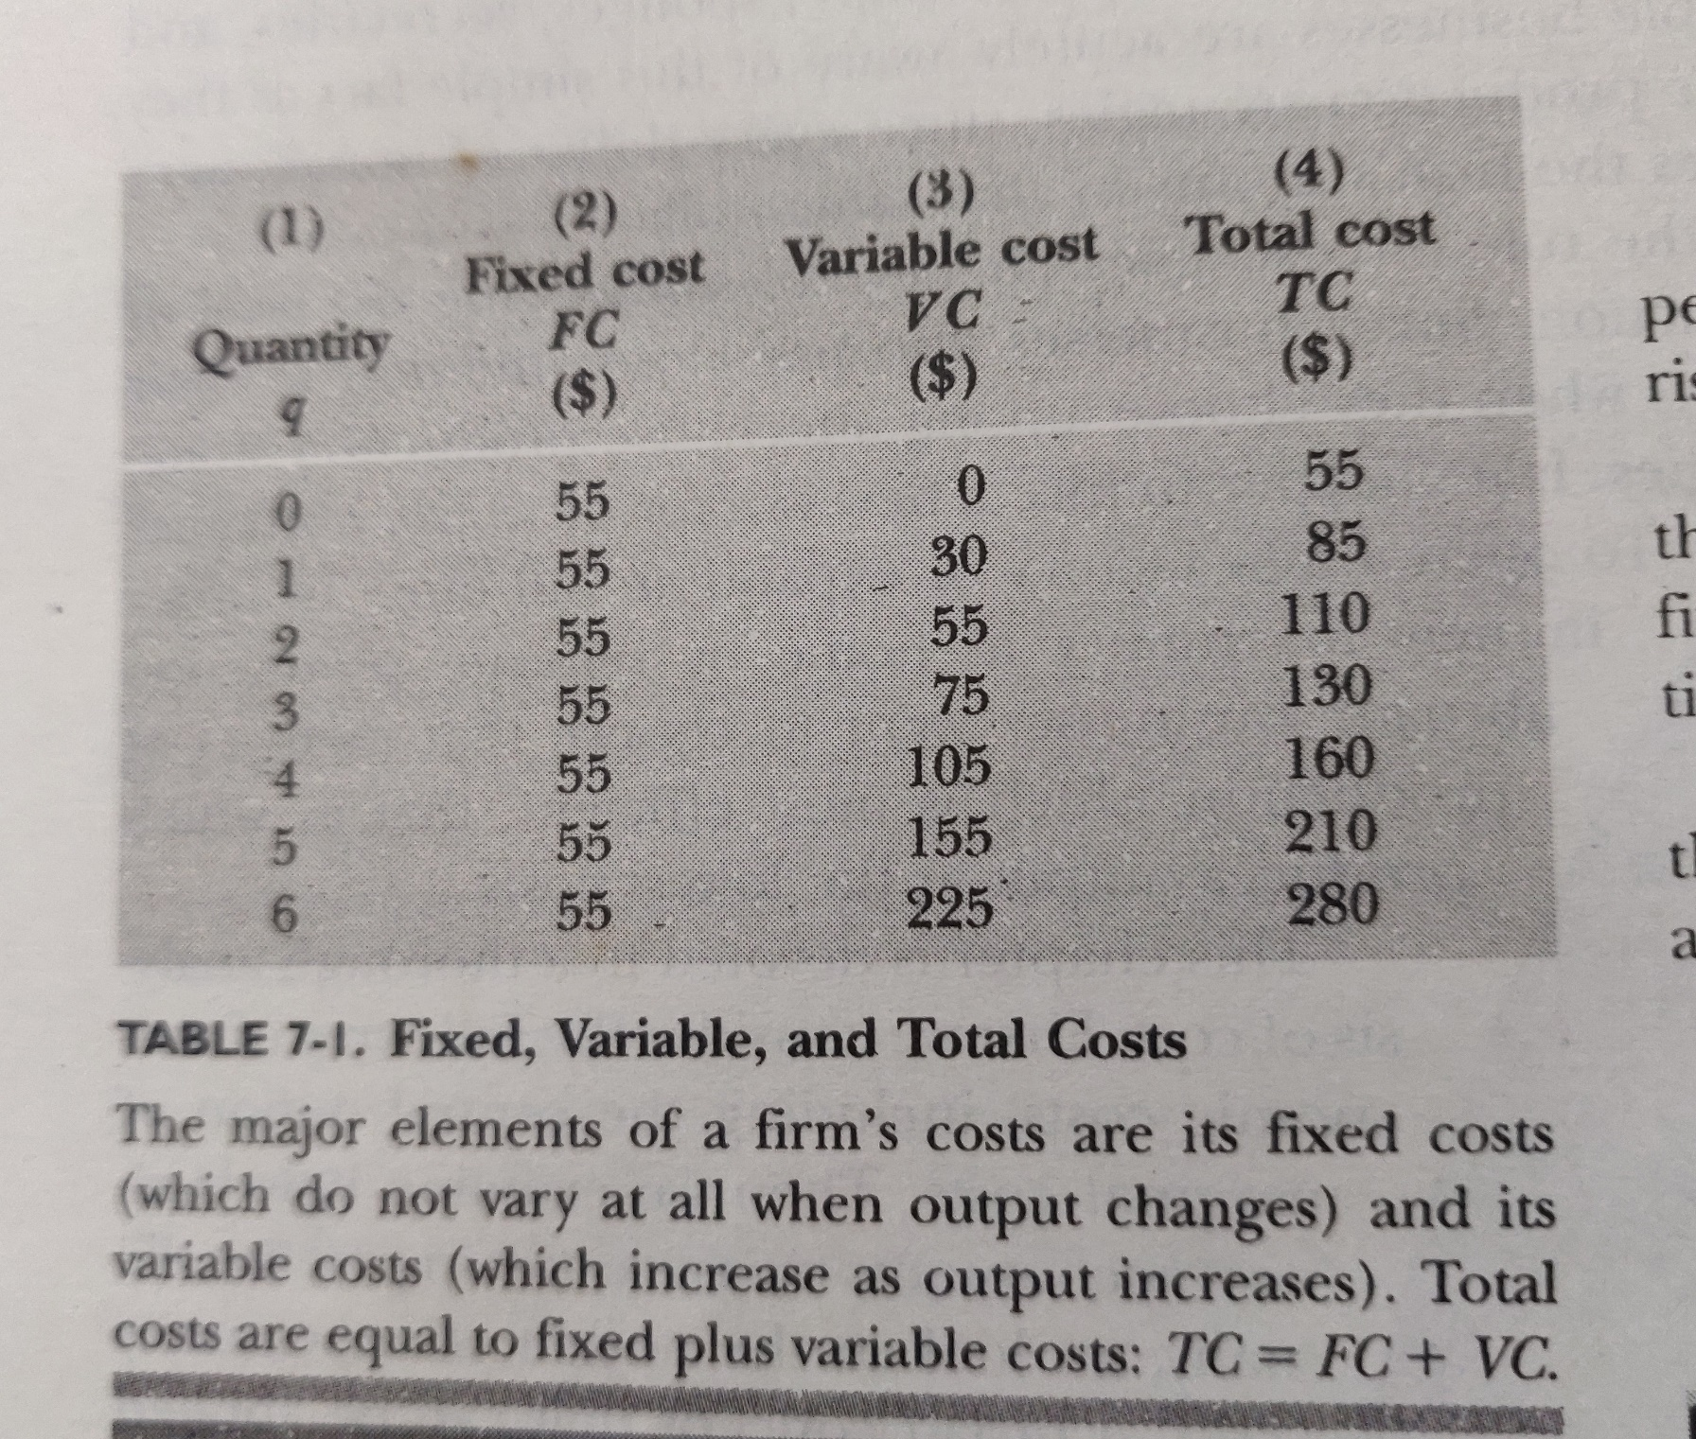

Slide 43
MARGINAL Cost
Marginal cost is one of the most important concepts in all economics.
MC denotes the extra or additional cost of producing 1 extra unit of output.

Slide 44
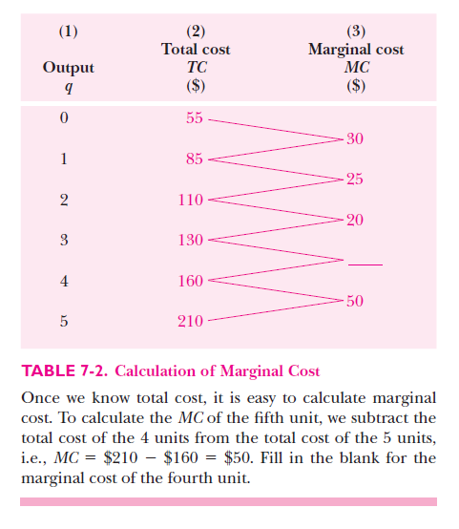

Slide 45
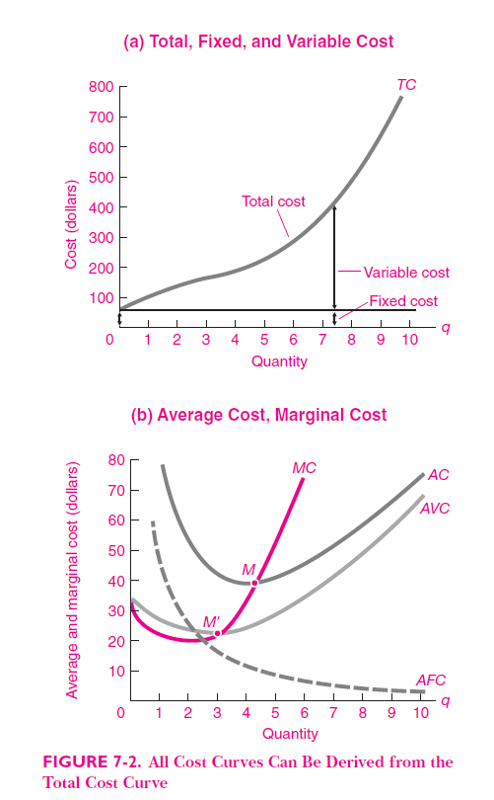

Slide 46
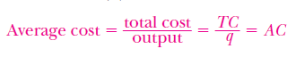
Average or Unit Cost
Average cost ( AC ) is a concept widely used in business; by comparing average cost with price or average revenue, businesses can determine whether or not they are making a profit.
Average cost is the total cost divided by the total number of units produced.

Slide 47
Average total cost is total cost divided by the quantity of output. Since the total cost of producing 40 haircuts at “The Clip Joint” is $320, the average total cost for producing each of 40 haircuts is $320/40, or $8 per haircut. Average cost curves are typically U-shaped. Average total cost starts off relatively high, because at low levels of output total costs are dominated by the fixed cost; mathematically, the denominator is so small that average total cost is large.
Average total cost then declines, as the fixed costs are spread over an increasing quantity of output. In the average cost calculation, the rise in the numerator of total costs is relatively small compared to the rise in the denominator of quantity produced. But as output expands still further, the average cost begins to rise. At the right side of the average cost curve, total costs begin rising more rapidly as diminishing returns kick in.
the law of diminishing returns - a principle stating that profits or benefits gained from something will represent a proportionally smaller gain as more money or energy is invested in it.

Slide 48
Average Fixed and Variable Costs
Just as we separated total cost into fixed and variable costs, we can also break average cost into fixed and variable components.
Average fixed cost ( AFC ) is defined as FC/q . Since total fixed cost is a constant, dividing it by an increasing output gives a steadily falling average fixed cost curve.
In other words, as a firm sells more output, it can spread its overhead cost over more and more units.

Slide 49
Average variable cost ( AVC ) equals variable cost divided by output, or AVC = VC/q .
Average variable cost obtained when variable cost is divided by quantity of output. For example, the variable cost of producing 80 haircuts is $400, so the average variable cost is $400/80, or $5 per haircut. Note that at any level of output, the average variable cost curve will always lie below the curve for average total cost.
The reason is that average total cost includes average variable cost and average fixed cost. Thus, for Q = 80 haircuts, the average total cost is $8 per haircut, while the average variable cost is $5 per haircut. However, as output grows, fixed costs become relatively less important (since they do not rise with output), so average variable cost sneaks closer to average cost. Average total and variable costs measure the average costs of producing some quantity of output.

Slide 50
The Relation between Average Cost and Marginal Cost
It is important to understand the link between average cost and marginal cost. We begin with three
closely related rules:
1. When marginal cost is below average cost, it is pulling average cost down.
2. When MC is above AC , it is pulling up AC .
3. When MC just equals AC, AC is constant. At the bottom of a U-shaped AC,
MC = AC = minimum AC.

Slide 51
This idea of the marginal cost “pulling down” the average cost or “pulling up” the average cost may sound abstract, but think about it in terms of your own grades. If the score on the most recent quiz you take is lower than your average score on previous quizzes, then the marginal quiz pulls down your average. If your score on the most recent quiz is higher than the average on previous quizzes, the marginal quiz pulls up your average. In this same way, low marginal costs of production first pull down average costs and then higher marginal costs pull them up.

Slide 52
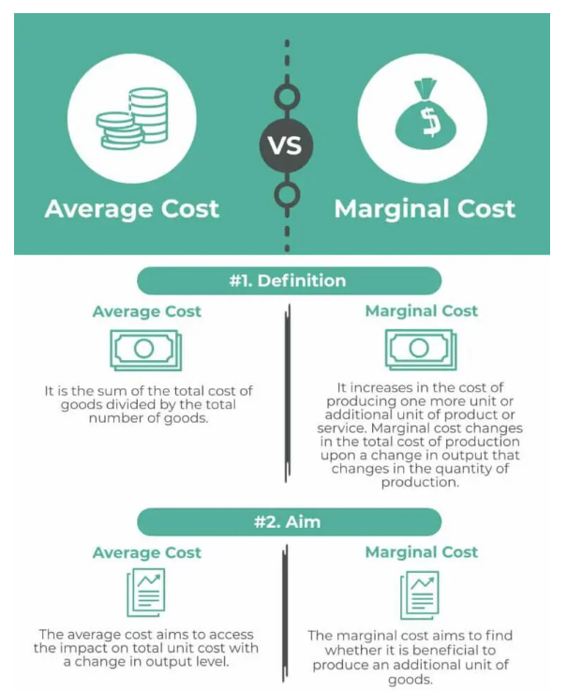

Slide 53
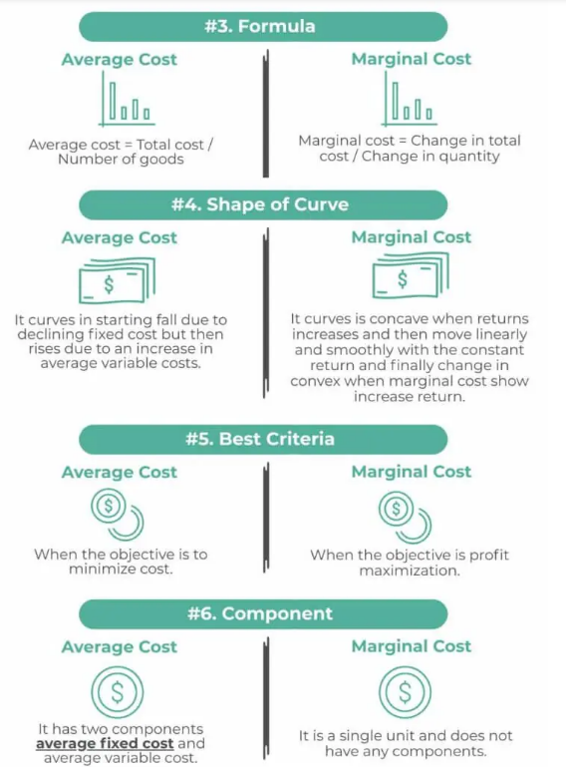

Slide 54
Production, Cost Theory and Decisions of the Firm
A numerical production function:
Production theory and cost analysis have their roots in the concept of a production function, which shows the maximum amount of output that can be produced with various combinations of inputs.

Slide 55
Table 7A-1 starts with a numerical example of a constant-returns-to-scale production function, showing the amount of inputs along the axes and the amount of output at the grid points of the table. Along the left-hand side are listed the varying amounts of land, going from 1 unit to 6 units. Along the bottom are listed amounts of labor, which also go from 1 to 6. Output corresponding to each land row and labor column is listed inside the table.
If we are interested in knowing exactly how much output there will be when 3 units of land and 2 units of labor are available, we count up 3 units of land and then go over 2 units of labor. The answer is seen to be 346 units of product.

Slide 56
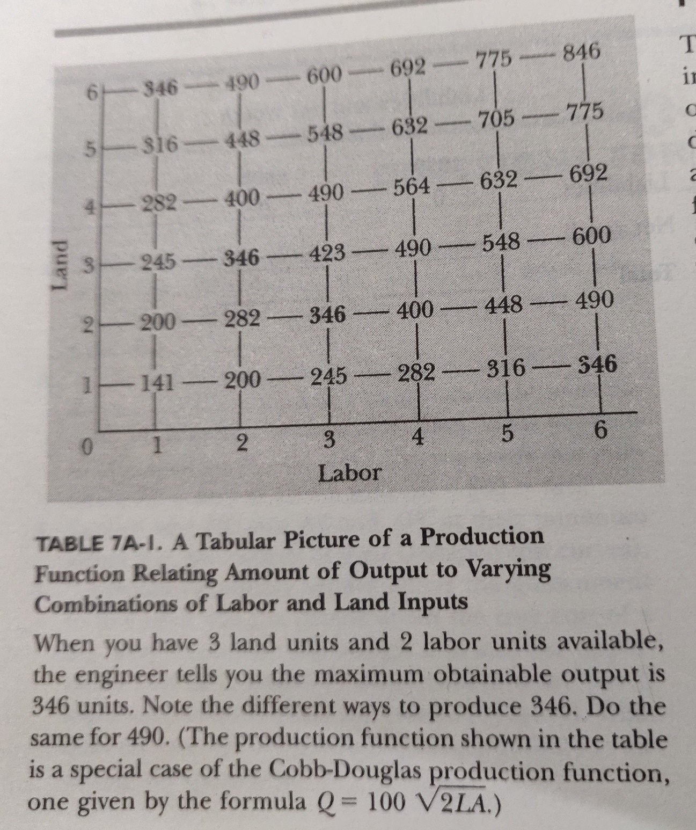

Slide 57
The law of diminishing marginal product
Marginal product of labor is the extra product resulting from 1 additional unit of labour when land is held constant.
Above example in table 7A.I when there are 2 units of land and 5 units of labor, the marginal product of an additional laborer would be 48 or 448 minus 400 in the second row.
Marginal product of land is the extra product resulting from 1 additional unit of land when labor is held constant

Slide 58
The law of diminishing returns states that as we increase one input and hold other inputs constant, the marginal product of the varying input will, at least after some point decline.
To illustrate this, hold land constant in table 7A-1 by sticking to a given row – say, the row corresponding to land equal to 2 units. Now let labor increase from 1 to 2 units, from 2 to 3 and so forth. What happens to q at each step?

Slide 59
Returns to Scale
“The term returns to scale refers to the changes in output as all factors change by the same proportion.”
Returns to scale are of the following three types:
1. Increasing Returns to scale.
2. Constant Returns to Scale
3. Diminishing Returns to Scale

Slide 60
A constant return to scale is when an increase in input results in a proportional increase in output. Increasing returns to scale is when the output increases in a greater proportion than the increase in input. Decreasing returns to scale is when all production variables are increased by a certain percentage resulting in a less-than-proportional increase in output.
For example, if a soap manufacturer doubles its total input but gets only a 40% increase in total output, it can be said to have experienced decreasing returns to scale. If the same manufacturer ends up doubling its total output, it has achieved constant returns to scale. If the output increased by 120%, the manufacturer experienced increasing returns to scale.

Slide 61
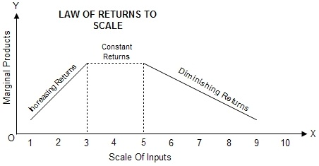

Slide 62
Diminishing marginal returns is an effect of increasing input in the short run after an optimal capacity has been reached. At the same time, at least one production variable is kept constant, such as labor or capital. The law states that this increase in the input will result in smaller increases in output. Returns to scale measure the change in productivity from increasing all production inputs in the long run.
Example of Diminishing Marginal Returns
For example, a restaurant hiring more cooks while keeping the same kitchen space can increase total output to a point, but every additional cook takes up space, eventually leading to smaller increases in output as there are too many cooks in the kitchen. The total output can decrease at some point, resulting in negative returns if too many cooks get in each other's way and eventually become unproductive.

